Slide 1



Navigating the parameter space of Bayesian Knowledge Tracing models
Visualizations of the convergence of the Expectation Maximization algorithm
Zachary A. Pardos, Neil T. Heffernan
Worcester Polytechnic Institute
Department of Computer Science
Notes:
Goals of this work:
1.) To gain a better understanding of the behavior of expectation maximization with the widely used standard knowledge tracing model
2.) To explore the potential of a new model which is an extension to knowledge tracing

Slide 2
Outline
Introduction
Knowledge Tracing/EM
Past work
Research Overview
Analysis Procedure
Results (pretty pictures)
Contributions
Presentation available: wpi.edu/~zpardos

Slide 3
Introduction of BKT
Bayesian Knowledge Tracing (BKT) is a hidden Markov model that estimates the probability a student knows a particular skill based on:
the student’s past history of incorrect and correct responses to problems of that skill
the four parameters of the skill
Prior: The probability the skill was known before use of the tutor
Learn rate: the probability of learning the skill between each opportunity
Guess: The probability of answering correctly if the skill is not known
Slip: the probability of answering incorrectly if the skill is known

Slide 4
Introduction of EM
Expectation Maximization (EM) algorithm is a commonly used algorithm for learning parameters based on maximum likelihood estimates.
EM is especially well suited to learn the four BKT parameters because it supports learning parameters for models with unobserved or latent variables
Latent

Slide 5
Motivation
Results of past and emerging work by the authors rely on interpretation of parameters learned with BKT and EM
Pardos, Z. A., Heffernan, N. T. (2009). Determining the Significance of Item Order In Randomized Problem Sets. In Barnes, Desmarais, Romero, & Ventura (Eds.). In Proceedings of the 2nd International Conference on Educational Data Mining. pp. 151-160. Cordoba, Spain. *Best Student Paper
Pardos, Z. A., Dailey, M. D., Heffernan, N. T. In Press (2010) Learning what works in ITS from non-traditional randomized controlled trial data. In Proceedings of the 10th International Conference on Intelligent Tutoring Systems. Pittsburg, PA. Springer-Verlag: Berlin. *Nominated for Best Student Paper

Slide 6
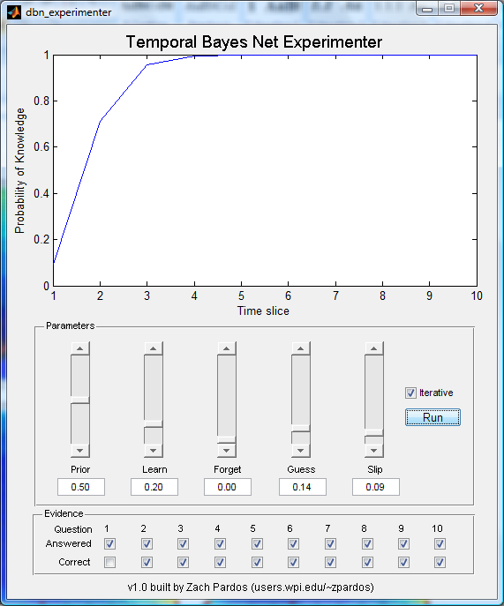
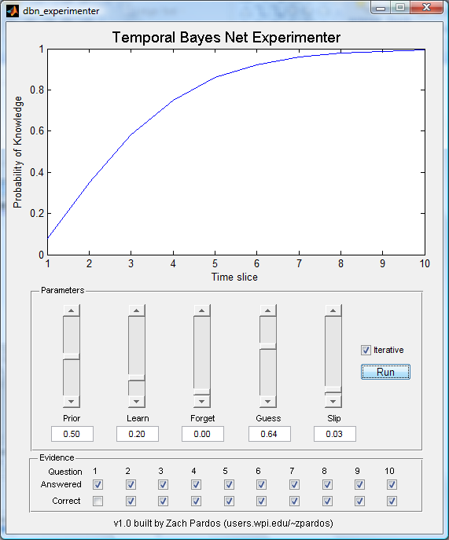
Motivation
Learned parameter values work to dictate when a student should advance in a curriculum in the Cognitive Tutors

Slide 7
Past work and relevance
Beck et al (2007) expressed caution with using Knowledge Tracing, giving an example of how KT could fit data equally well with two separate sets of learned parameters. One set being the plausible set, the other being the degenerate set.
Proposed using Dirichlet priors to keep parameters close to reasonable values
Better fit was not accomplished with this method when learning the parameters from data

Slide 8
Past work and relevance
Baker (2009) argued that using brute force to fit the parameters of KT results in a better fit than when using Expectation Maximization (personal communication)
Gong et al are challenging this at EDM2010
Work by Baker & Corbett has addressed the degenerate parameter problem by bounding the learned parameter values

Slide 9
Past work and relevance
Ritter et al (2009) used visualization of the KT parameters to show how many of the Cognitive tutor skills were being fit with similar parameters. The authors used that information to cluster the learning of groups of skills; saving compute time with negligible impact on accuracy.

Slide 10

Research Overview
Bayesian Knowledge Tracing: Method for estimating if a student knows a skill or not based on the student’s past responses and the parameter values of the skill
Expectation Maximization (EM): Method for estimating the skill parameters for Bayesian Knowledge Tracing
Bad fit
Ineffective learning
Bad pedagogical decisions
Initial EM parameters
Good fit
Effective learning
Many publications
You’re a hero
EM needs starting values for the parameters to begin its search
Notes:
Effective and efficient learning

Slide 11
Research Overview
Bayesian Knowledge Tracing: Method for estimating if a student knows a skill or not based on the student’s past responses and the parameter values of the skill
Expectation Maximization (EM): Method for estimating the skill parameters for Bayesian Knowledge Tracing
Bad fit
Ineffective learning
Bad pedagogical decisions
Research Questions:
Are the starting locations that lead to good fit scattered randomly?
Initial EM parameters
Good fit
Effective learning
Many publications
You’re a hero
EM needs starting values for the parameters to begin its search
Notes:
Effective and efficient learning

Slide 12
Research Overview
Bayesian Knowledge Tracing: Method for estimating if a student knows a skill or not based on the student’s past responses and the parameter values of the skill
Expectation Maximization (EM): Method for estimating the skill parameters for Bayesian Knowledge Tracing
Bad fit
Ineffective learning
Bad pedagogical decisions
Research Questions:
Are the starting locations that lead to good fit scattered randomly?
Initial EM parameters
Do they exist within boundaries?
Good fit
Effective learning
Many publications
You’re a hero
EM needs starting values for the parameters to begin its search
Notes:
Effective and efficient learning

Slide 13
Research Overview
Bayesian Knowledge Tracing: Method for estimating if a student knows a skill or not based on the student’s past responses and the parameter values of the skill
Expectation Maximization (EM): Method for estimating the skill parameters for Bayesian Knowledge Tracing
Bad fit
Ineffective learning
Bad pedagogical decisions
Research Questions:
Are the starting locations that lead to good fit scattered randomly?
Initial EM parameters
Do they exist within boundaries?
Can good convergence always be achieved?
Good fit
Effective learning
Many publications
You’re a hero
EM needs starting values for the parameters to begin its search
Notes:
Effective and efficient learning

Slide 14
Past work and relevance
Past work lacks the benefit of knowing the ground truth parameters
This makes it difficult to study the behavior of EM and measure the accuracy of learned parameters

Slide 15
Our approach: Simulation
Approach of this work is to
construct a BKT model with known parameters
simulate student responses by sampling from that model
explore how EM converges or does not converge to the ground truth parameters based a grid-search of initial parameter starting positions
since we know the true parameters we can now study the accuracy of parameter learning in depth

Slide 16
Research Overview
Bad fit
Ineffective learning
Bad pedagogical decisions
Inaccurate fit
Initial EM parameters
Accurate fit
Good fit
Effective learning
Many publications
You’re a hero
Notes:
Effective and efficient learning

Slide 17
Simulation Procedure
KTmodel.lrate = 0.09
KTmodel.guess = 0.14
KTmodel.slip = 0.09
KTmodel.num_questions = 4
For user 1 to 100
prior(user) = rand()
KTmodel.prior = prior(user)
sim_responses(user) = sample.KTmodel
End For

Slide 18
Simulation Procedure
Simulation produces a vector of responses for each student probabilistically based on underlying parameter values
EM can now try to learn back the true parameters from the simulated student data
EM allows the user to specify which initialization values of the KT parameters should be fixed and which should be learned

Slide 19
Simulation Procedure
We can start to build intuition about EM by fixing the prior and learn rate and having only two free parameter to learn (Guess and Slip)
Prior: 0.49 (fixed)
Learn rate: 0.09 (fixed)
Guess: learned
Slip: learned
We can see how well EM does with two free parameters and then then later step up to the more complexity four free parameter case

Slide 20
Grid-search Procedure
Learning the Guess and Slip parameter from Data
Prior and Learn rate already known (fixed)
GuessT (true parameter) | SlipT (true parameter)
0.14 | 0.09
GuessI (EM initial parameter) | SlipI (EM initial parameter)
0.36 | 0.40
GuessL (EM learned parameter) | SlipL (EM learned parameter)
0.23 | 0.11
Error = (abs(GuessT – GuessL) + abs(SlipT – SlipL)) / 2

Slide 21
Grid-search Procedure
These parameters are iterated in intervals of 0.02
1 / 0.02 + 1 = 51, 51*51 = 2601 total iterations
EM log likelihood
Higher = better fit to data
GuessT | SlipT | GuessI | SlipI | GuessL | SlipL | Error | LLstart | LLend
0.14 | 0.09 | 0.00 | 0.00 | 0.00 | 0.00 | 0.1150 | -1508 | -1508
0.14 | 0.09 | 0.00 | 0.02 | 0.23 | 0.14 | 0.1390 | -344 | -251
0.14 | 0.09 | 0.00 | 0.04 | 0.23 | 0.14 | 0.1390 | -309 | -251
… | … | … | … | … | … | … | … | …
0.14 | 0.09 | 1.00 | 1.00 | 1.00 | 1.00 | 0.8850 | -1645 | -1645
Resulting data file after all iterations are completed

Slide 22
Grid-search Procedure
These parameters are iterated in intervals of 0.02
1 / 0.02 + 1 = 51, 51*51 = 2601 total iterations
EM log likelihood
Higher = better fit to data
GuessT | SlipT | GuessI | SlipI | GuessL | SlipL | Error | LLstart | LLend
0.14 | 0.09 | 0.00 | 0.00 | 0.00 | 0.00 | 0.1150 | -1508 | -1508
0.14 | 0.09 | 0.00 | 0.02 | 0.23 | 0.14 | 0.1390 | -344 | -251
0.14 | 0.09 | 0.00 | 0.04 | 0.23 | 0.14 | 0.1390 | -309 | -251
… | … | … | … | … | … | … | … | …
0.14 | 0.09 | 1.00 | 1.00 | 1.00 | 1.00 | 0.8850 | -1645 | -1645
Initial parameters of 0 or 1 will stay at 0 or 1

Slide 23
Grid-search Procedure
These parameters are iterated in intervals of 0.02
1 / 0.02 + 1 = 51, 51*51 = 2601 total iterations
EM log likelihood
Higher = better fit to data
GuessT | SlipT | GuessI | SlipI | GuessL | SlipL | Error | LLstart | LLend
0.14 | 0.09 | 0.00 | 0.00 | 0.00 | 0.00 | 0.1150 | -1508 | -1508
0.14 | 0.09 | 0.00 | 0.02 | 0.23 | 0.14 | 0.1390 | -344 | -251
0.14 | 0.09 | 0.00 | 0.04 | 0.23 | 0.14 | 0.1390 | -309 | -251
… | … | … | … | … | … | … | … | …
0.14 | 0.09 | 1.00 | 1.00 | 1.00 | 1.00 | 0.8850 | -1645 | -1645
Grid-search run in intervals of 0.02

Slide 24
Visualizations
What does the parameter space look like?
Which starting locations lead to the ground truth parameter values?

Slide 27
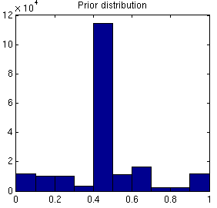
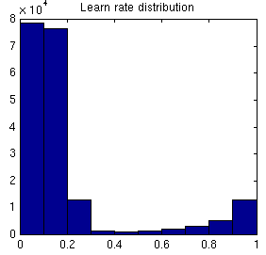
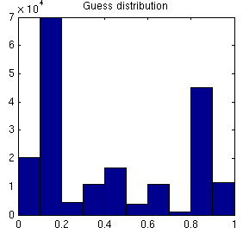
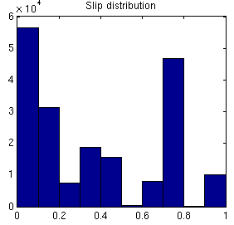
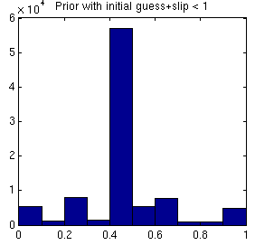
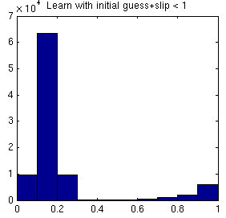
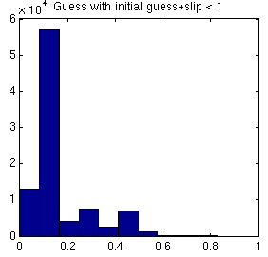
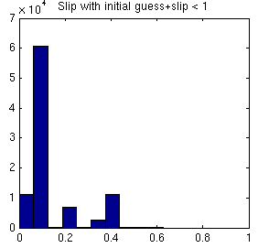
Analyzing the 3 & 4 parameter case
Similar results were found with the 3 parameter case with learn, guess and slip as free parameters. The starting position of the learn parameter wasn’t important as long as guess + slip <= 1
In the four parameter case a grid-search was run at 0.05 resolution and histograms were generated showing the frequency of parameter occurrences. We found that when guess and slip were set to sum to less than 1, the bottom row of histograms were achieved that minimized degenerate parameter occurrences.

Slide 28
Pardos, Z. A., Heffernan, N. T. In Press (2010) Modeling Individualization in a Bayesian Networks Implementation of Knowledge Tracing. In Proceedings of the 18th International Conference on User Modeling, Adaptation and Personalization. Hawaii. *Nominated for Best Student Paper

Slide 29
KT vs. PPS visualizations
Knowledge Tracing
Prior Per Student
Ground truth parameters: guess/slip = 0.14/0.09

Slide 30
KT vs. PPS visualizations
Knowledge Tracing
Prior Per Student
Ground truth parameters: guess/slip = 0.30/0.30

Slide 31
KT vs. PPS visualizations
Knowledge Tracing
Prior Per Student
Ground truth parameters: guess/slip = 0.50/0.50

Slide 32
KT vs. PPS visualizations
Knowledge Tracing
Prior Per Student
Ground truth parameters: guess/slip = 0.60/0.10

Slide 33
PPS in the KDD Cup
Prior Per Student model used in KDD Cup competition submission.
PPS was the most accurate Bayesian predictor in all 5 of the Cognitive tutor datasets
Preliminary leaderboard RMSE: 0.279695
One place behind the netflix winners, BigChaos
This suggests that the positive simulation results are real, substantiated empirically

Slide 34
Contributions
EM starting parameter values that lead to degenerate learned parameters exist within large boundaries, not scattered randomly throughout the parameter space
Using a novel simulation approach and visualizations we were able to clearly depict the multiple maxima characteristics of Knowledge Tracing
Using this analysis of algorithm behavior we were able to explain the positive performance of the Prior Per Student model by showing its convergence near the ground truth parameters regardless of starting position
Initial values of Guess and Slip are very significant

Slide 35
Unknowns / Future Work
How does PPS compare to KT when priors are not from a uniform random distribution
Normal distribution
All students have the same prior
Bi-modal (high / low knowledge students)
How does length of sequence and number of students affect algorithm behavior?

Slide 36

Thank you
Please find a copy of our paper on the Prior Per Student model at http://wpi.edu/~zpardos
“Modeling Individualization in a Bayesian Networks Implementation of Knowledge Tracing”
Acknowledgement: This material is based in part upon work supported by the National Science Foundation under the GK-12 PIMPSE Grant. Disclaimer: Any opinions, findings, and conclusions or recommendations expressed in this material are those of the author(s) and do not necessarily reflect the views of the National Science Foundation.

Slide 37
Limitations of past work
Bounding approach has shown instances where the learned parameters all hit the bounding ceiling indicating that the best fit parameters may be higher than was arbitrarily set
Plausible parameter approach in part relies on domain knowledge to identify what is plausible and what is not
Reading tutors may have plausible guess/slip values > 0.70
Cognitive tutors’ plausible guess/slip values are < 0.40

